Slide 1
CRCNY Presents
Learn to Program in Python

Slide 2
The Project Team
Who are you and what would you like to achieve from this experience?

Slide 3
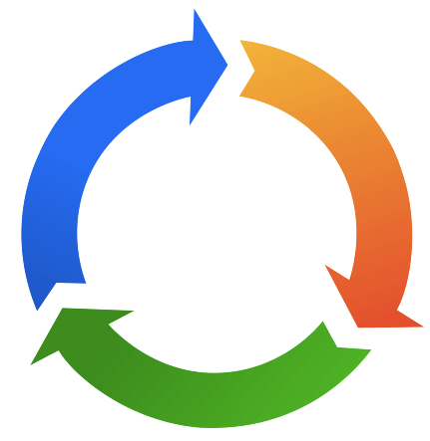
Course Competency Model
Technical
Leadership
Process

Slide 4
Define the course Project, Roles and Deliverables
Project
Roles
Deliverables (Final Product)

Slide 5
The Project Manager
Who am I ← (click)?
What can you expect from me?
What can I expect from you?

Slide 6
Topics discussed during project status / presentation
IT (Information Technology) Roles
  Business / Data Analyst
  Software Developer
SME (Subject Matter Expert) / DE (Domain Expert)
Projects
  Project Management
  Project Team
Software Development
  Software Product Manager
  Lean Development
  Agile Development
  SDLC (Software Development Life Cycle)

Slide 7

Lesson Plan
Lesson 1 – Variables
Lesson 2 – Loops
Lesson 3 – Conditions (If, Else Statements)
Lesson 4 – Booleans (True / False)
Lesson 5 - ???
Lesson 6 – Project Presentation

Slide 8
Lesson 1
[15 Mins] What is programming? → slides #3 - #11 / video
[5 Mins] Why Python? slide #5
[5 Mins] Codeacademy.com - account creation and Web GUI (Graphical User Interface) layout
[10 Mins] Pair Programming
  Create variables
[5 Mins] Discuss take home assignment
  What do you need to become a programmer? Ganas! → video
  Codeacademy - complete L1 (Lesson 1)
  Kaggle.com - create account and fork instructor's project script

Slide 9
Lesson 2
[15 Mins] What is programming? → slides #3 - #11 / video
[5 Mins] Why Python? slide #5
[5 Mins] Codeacademy.com - account creation and Web GUI (Graphical User Interface) layout
[10 Mins] Pair Programming
  Create variables
[5 Mins] Discuss take home assignment
  What do you need to become a programmer? Ganas! → video
  Codeacademy - complete L1 (Lesson 1)
  Kaggle.com - create account and fork instructor's project script

